Slide 1
Automated Script
Dr. Mohamed ElHadedi
Eng. Manar Rashad
Eng. Eman Abdelrazik
1

Slide 2
Our Team
Bio2go
Nadeen Nassif
Zahraa Omar
Salma Ayman
Rawan Ramadan
Ahmed Hesham
2

Slide 3
TABLE OF CONTENTS
01
02
03
04
Introduction
Methods
Results
Conclusion
3

Slide 4
PCG
Primary Congenital Glaucoma
4

Slide 5
01
WHAT IS PCG?
Rare genetic disease affects newborn children.
Damage the optic nerve 2,3 afterward
5

Slide 6
Applying methods of bioinformatics.
there are 5 genes contributing to this disease
Applying blast method get the most target gene.
6

Slide 7
Custom tkinter
Graphical User Interface (GUI)
7

Slide 8
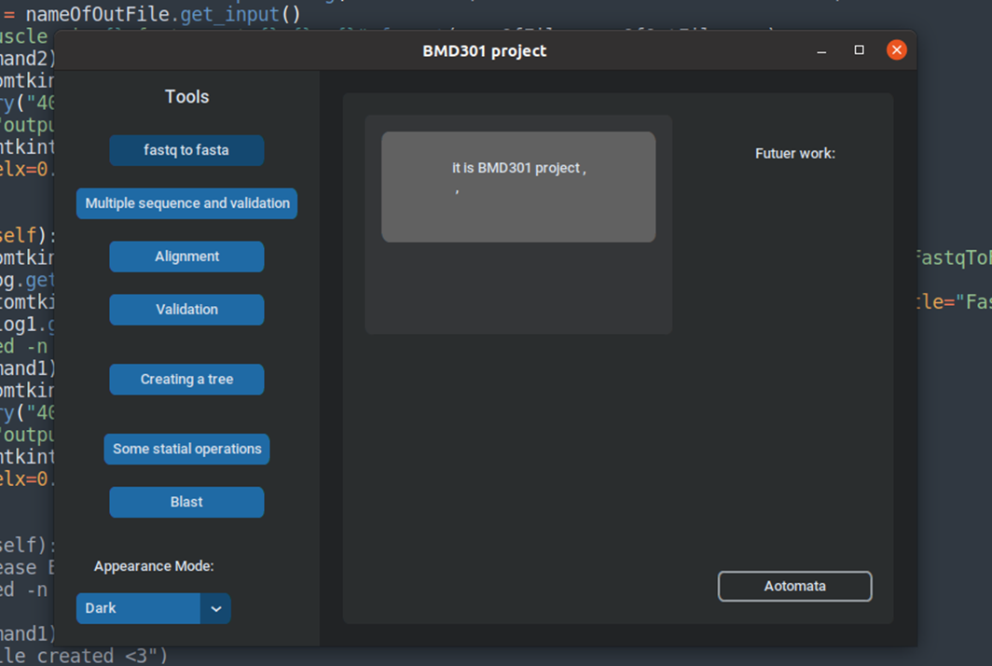
Custom Tkinter is a modern python UI-library based on Tkinter, it maybe hard to implement, but the result is amazing
Integration between python and command line by using OS module
8

Slide 9
FASTQ to FASTA file
9

Slide 10
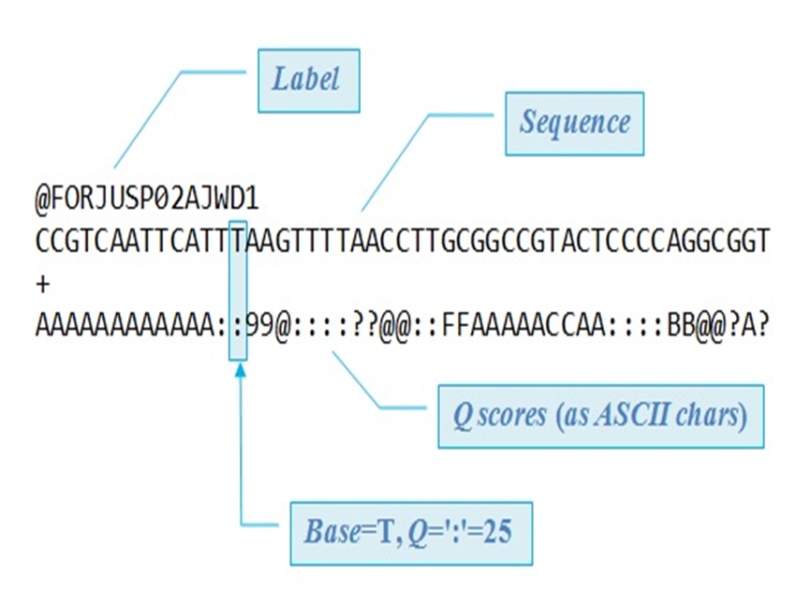
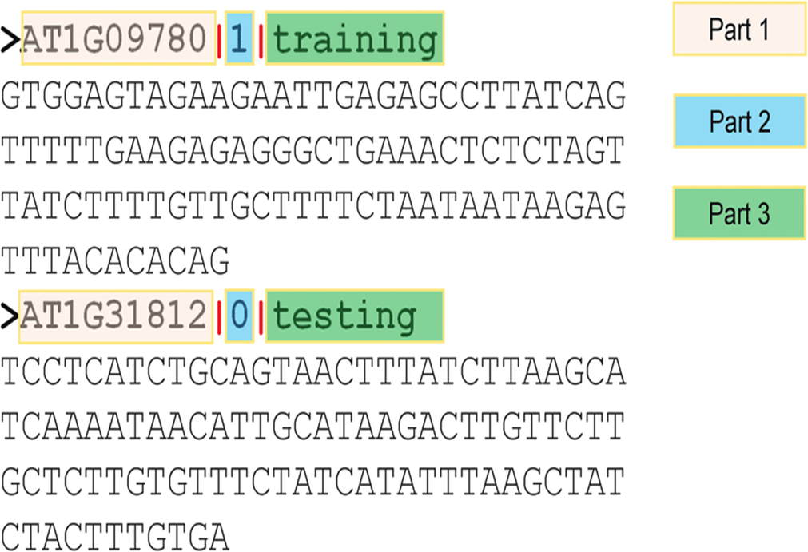
FASTQ and FASTA file
10

Slide 11
sed -n \'1~4s/^@/>/p;2~4p\' {}.fastq > {}.fasta
If we print the first and 2nd line of every 4 lines and replaced the @ at the first of the first line with > you get the sequence header and sequence needed for fasta format.
11

Slide 12
Pairwise Alignment
Local (BLAST) and Global
12

Slide 13
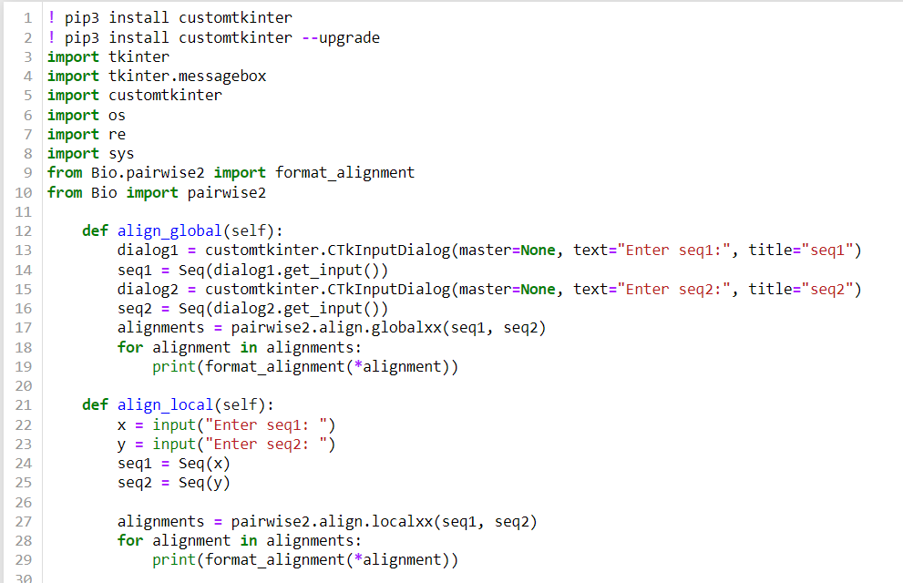
Local Vs Global
Local alignments are useful for finding regions of similarity between dissimilar sequences.
Global alignments do more of an end-to-end alignment between two sequences
13

Slide 14
BLAST (Basic Local Alignment Search Tool)
14

Slide 15
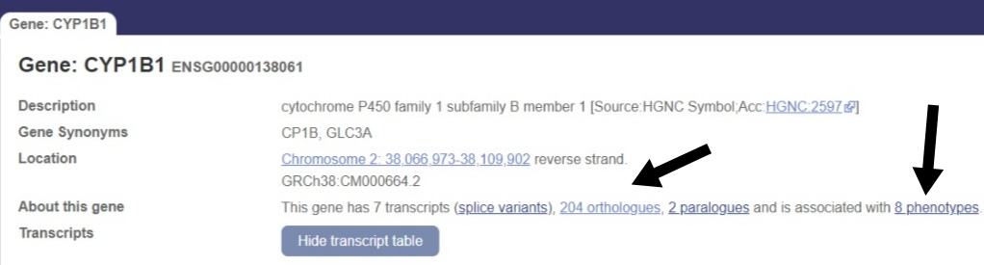
BLAST Steps
What do we need? (BLAST, query, database)
1. Downloading the query
15

Slide 16
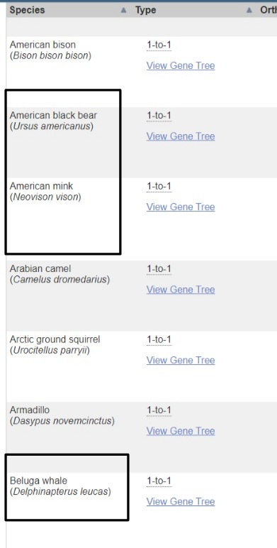
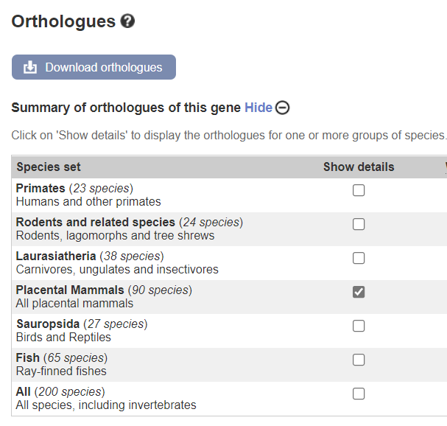
BLAST Steps
1. Downloading the query
16

Slide 17
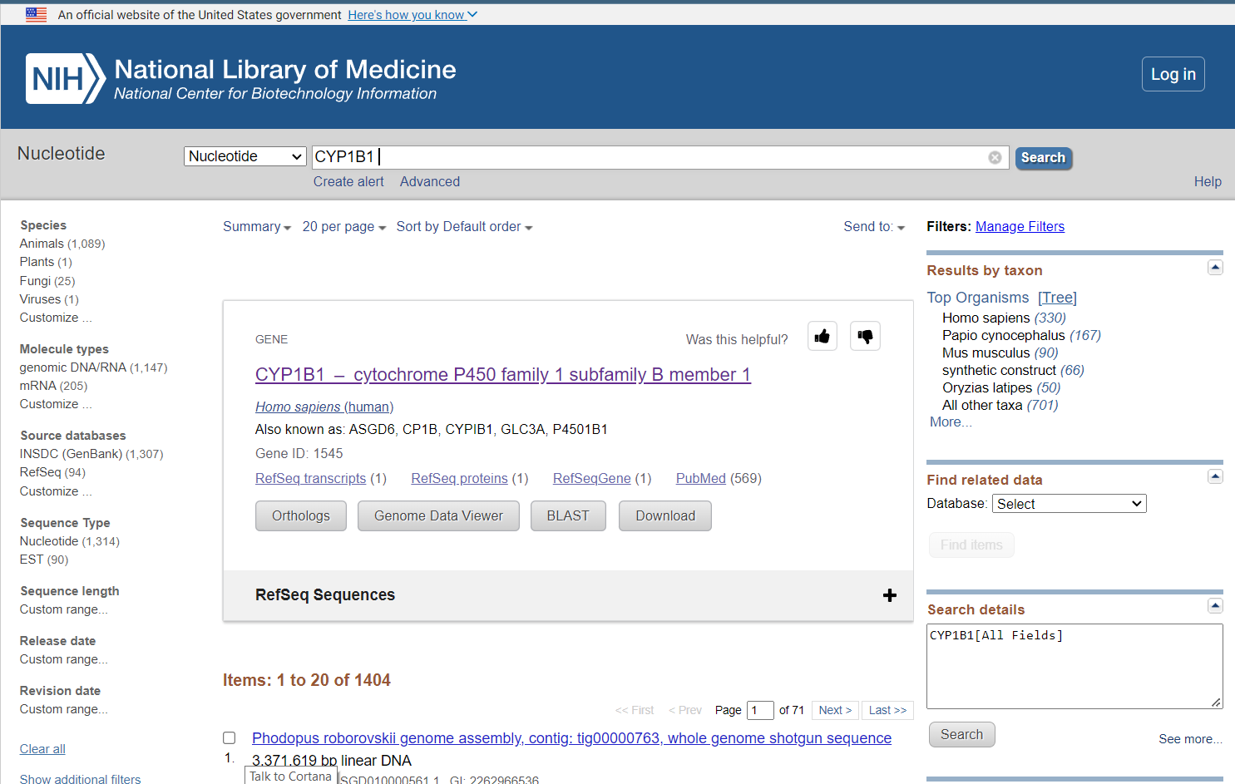
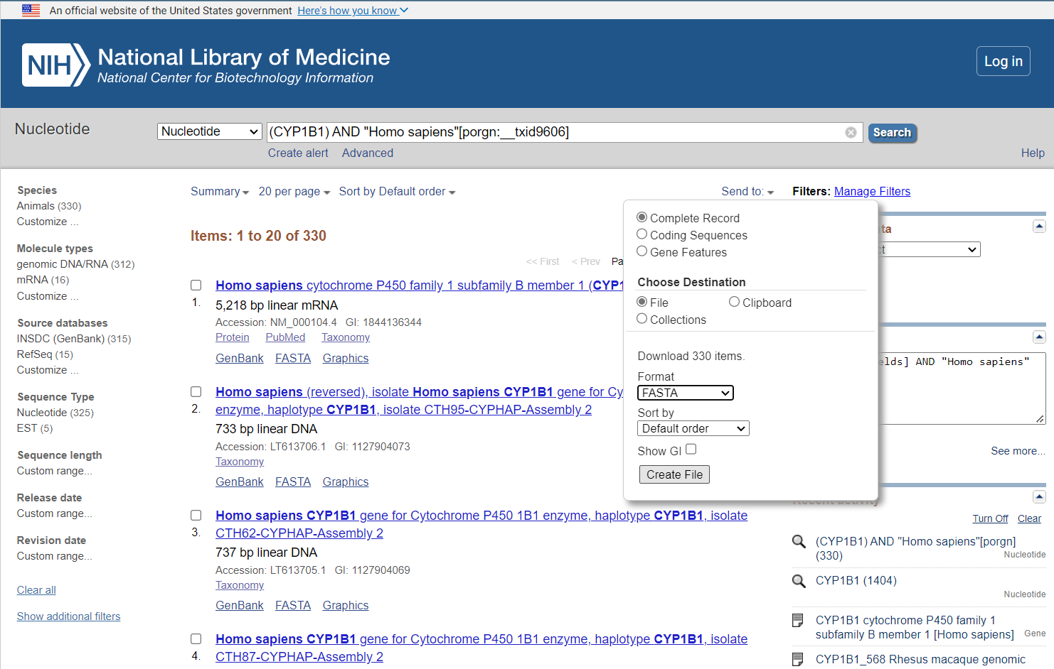
BLAST Steps
2. Customizing the database
2.7 Gb
803 Mb
17

Slide 18
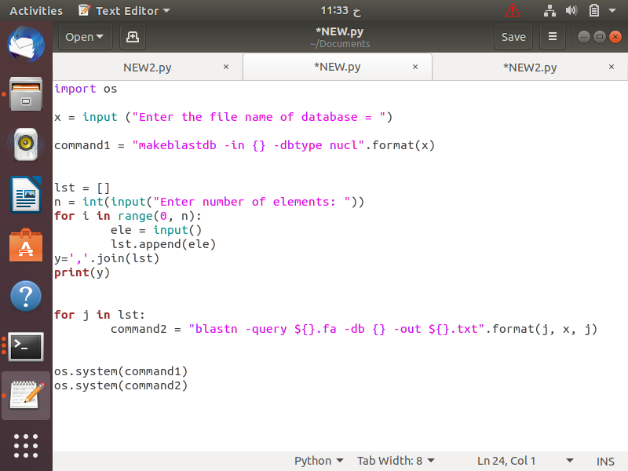
Automated BLAST Script
Ready to run the BLAST?
Install the Blast if needed
2. Indexing the database
3. BLAST command

Slide 19
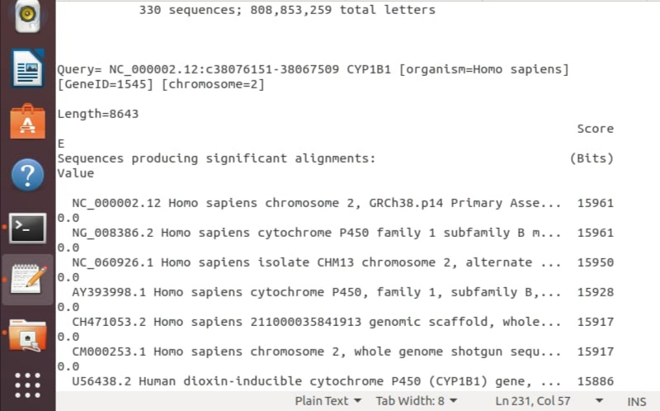
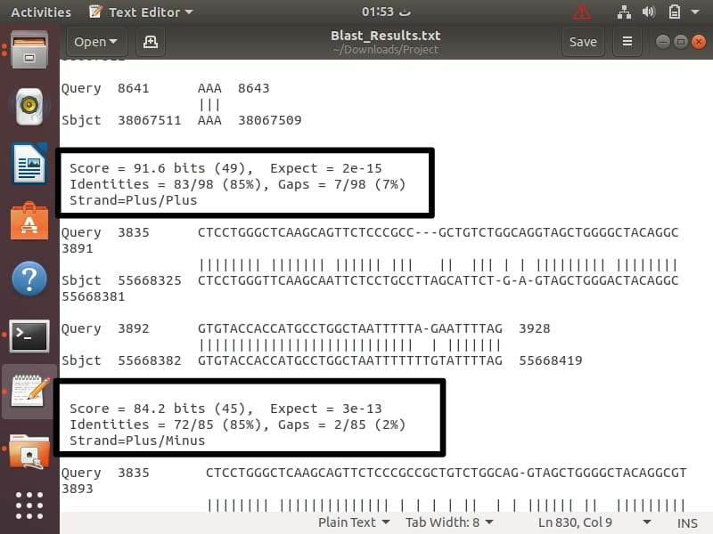
BLAST Results

Slide 20
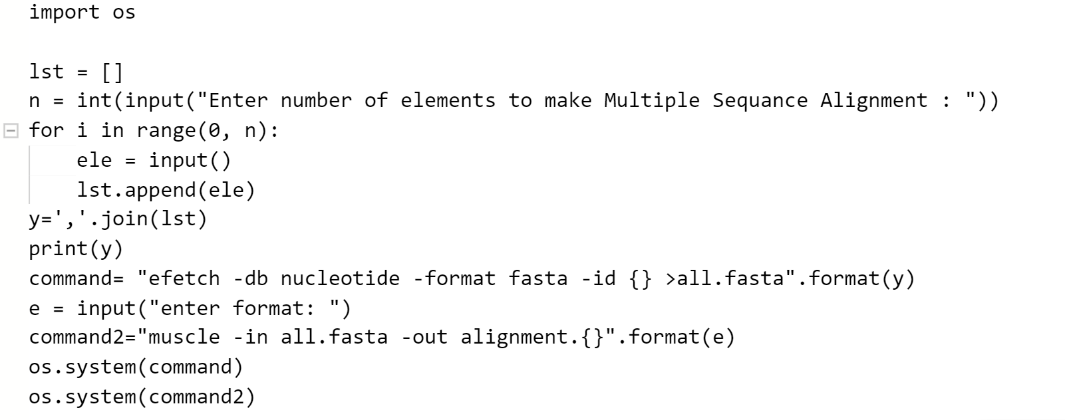
Multiple Sequence Alignment
Ask User:
relationships of nucleotide or protein sequence families
Fetch accession Number:
.
Muscle tool

Slide 21
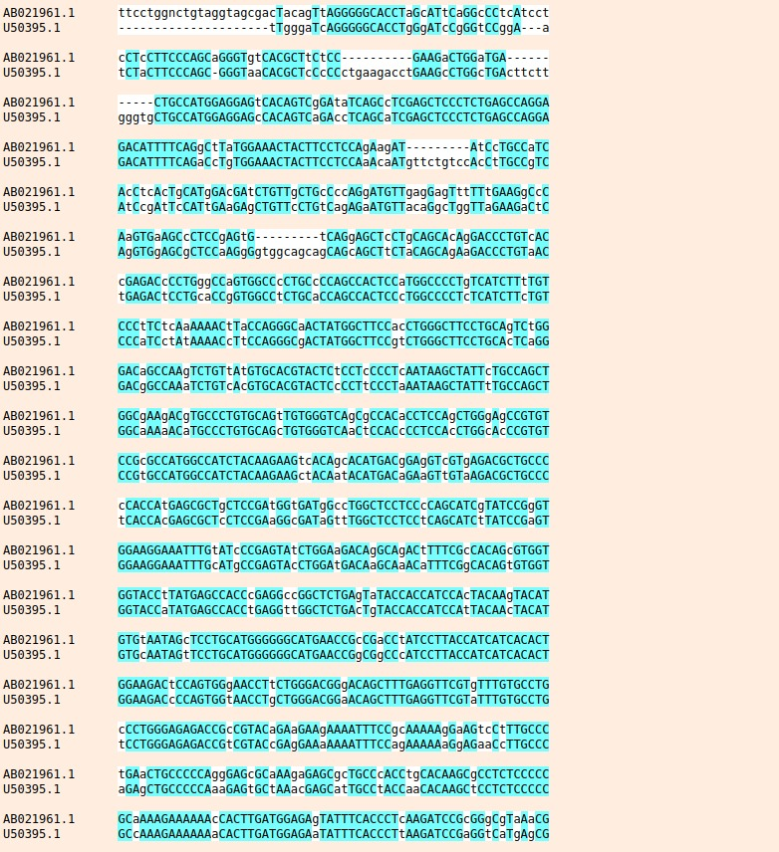

Slide 22
Phylogenetic tree

Slide 23
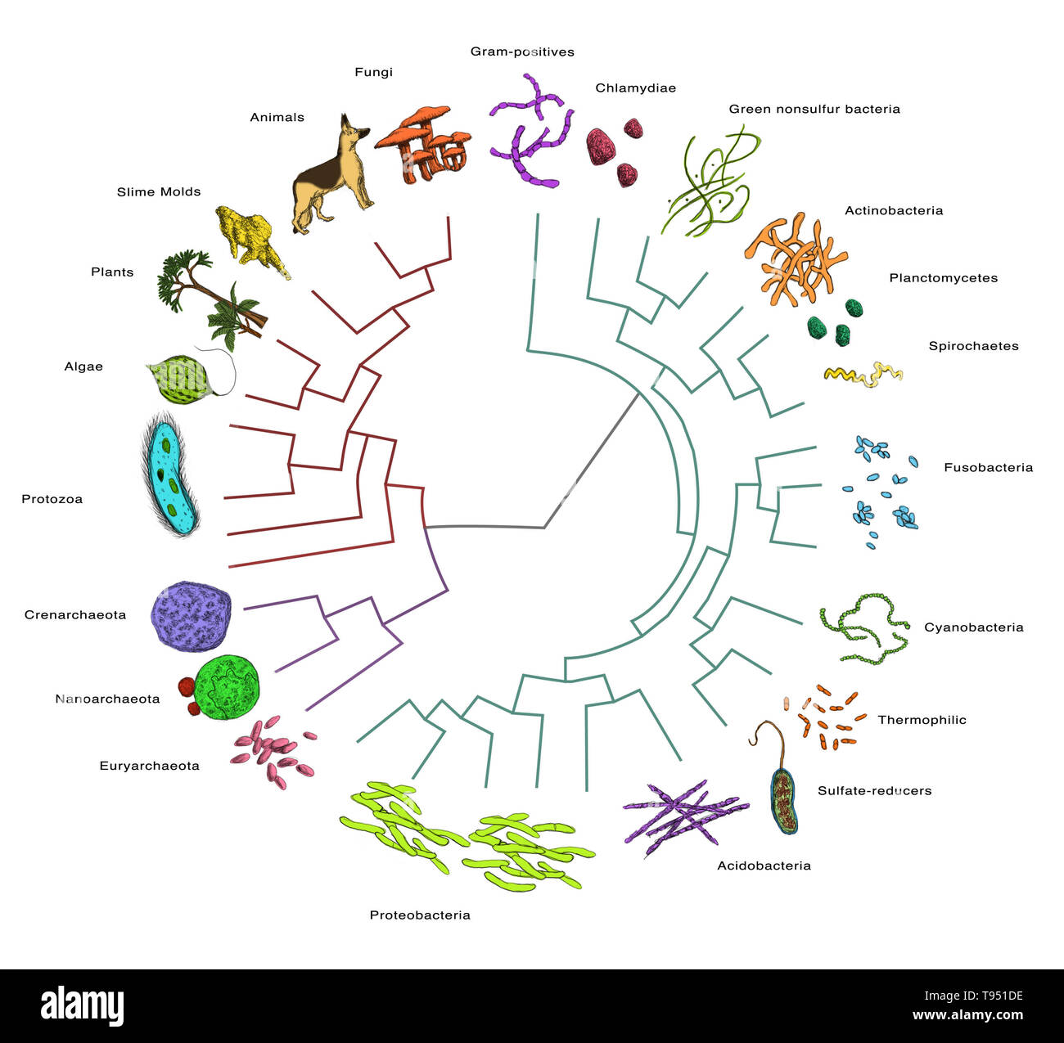
By applying the phylogenetic tree method to know from which species we got this gene that affects humans over the years.

Slide 24
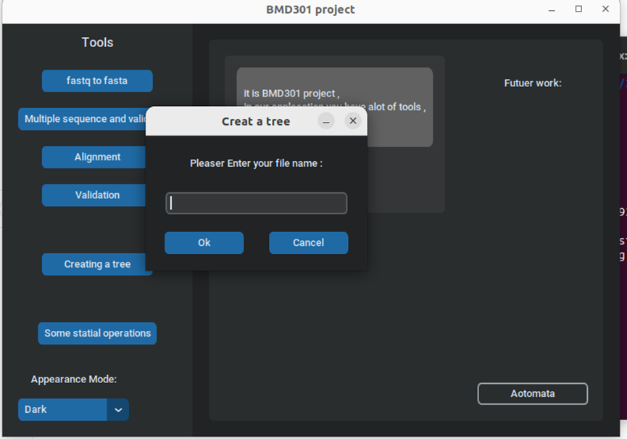
Steps for phylogenetic tree
The user enters the name of the file

Slide 25
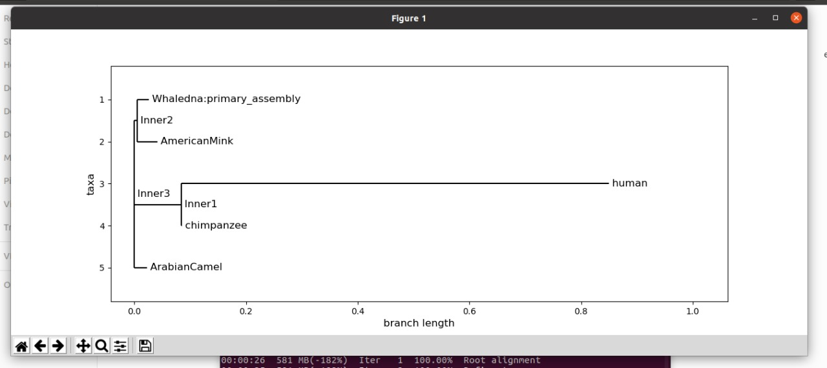
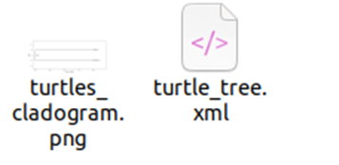
Results
The file saves as a photo and print out a file

Slide 26
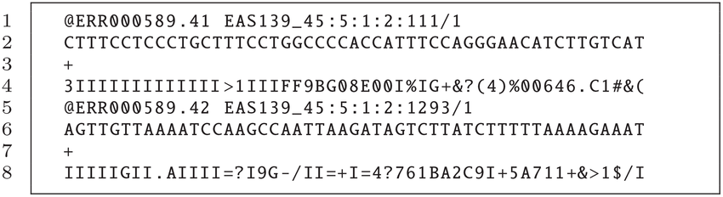
Validation FASTQ
Do you think Validation Of FASTQ File Important or not?

Slide 27

Why We need to Validate FASTQ?
to improve the data reusability and build error-proof data analysis processes. FASTQ validators detect reads, base calls and quality score mismatches, invalid encoding, etc.

Slide 28
How to validate FASTQ File?
Validate FASTQC
Validate of FASTQ file
We enable users to run a variety of quality control tests on raw sequence data produced in FASTQ format by high throughput sequencing platforms like Illumina According to the output result user will be able to identify the quality of sequence data.
Check if sequence data in FASTQ valid to use or non.

Slide 29
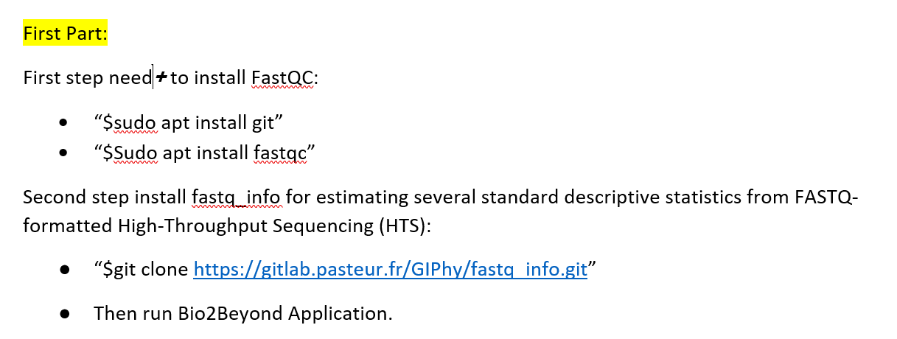
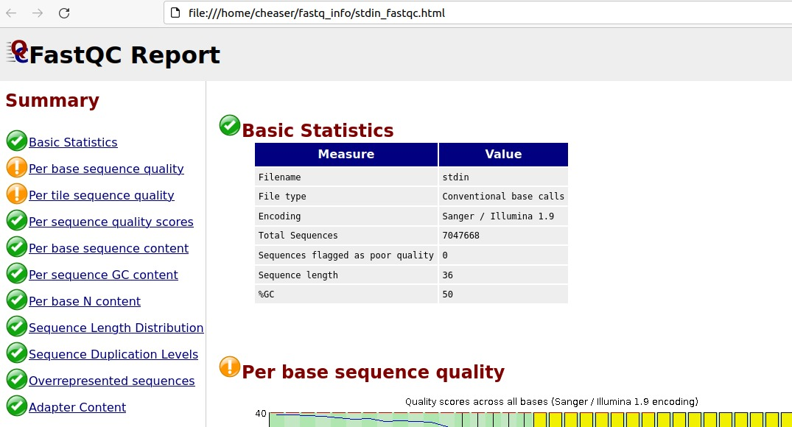
Validate FASTQC
Distribution of HTS read lengths,
Nucleotide residue content per HTS read position,
Distribution of the number of sequencing error(s)

Slide 30
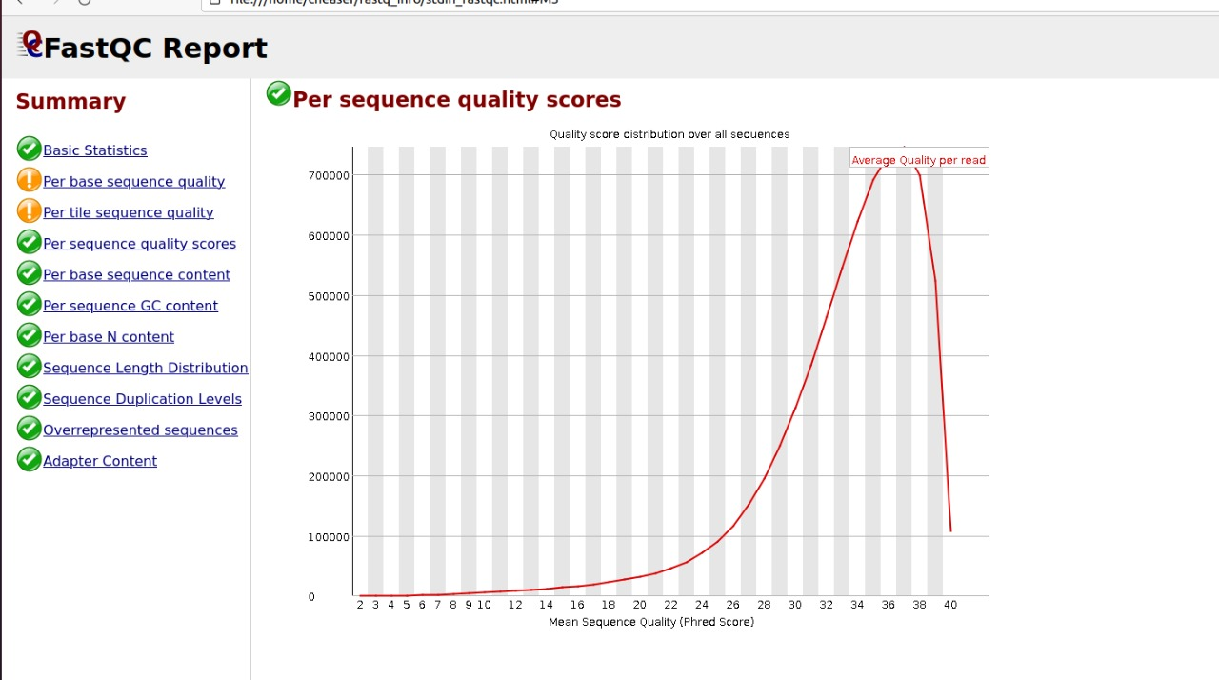
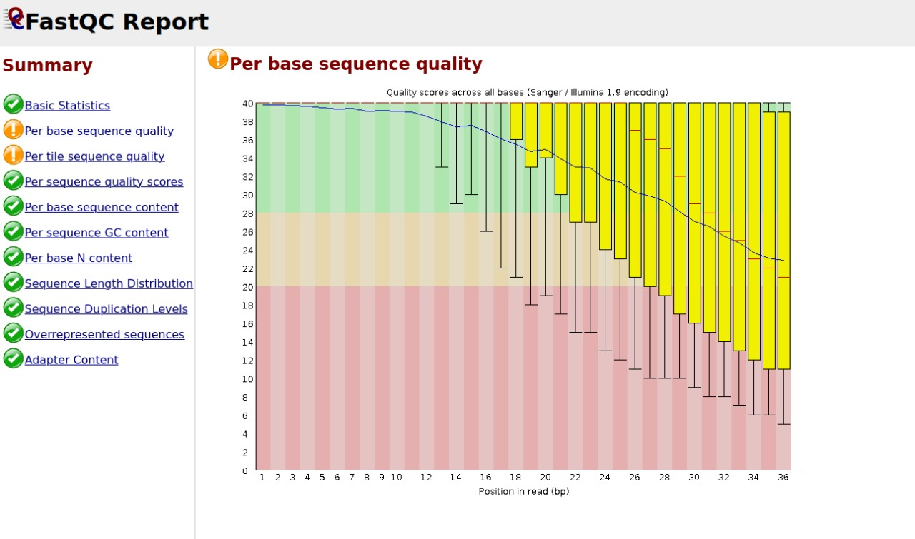
Quality Processing
Plots the percentage of each of the four nucleotides (T, C, A, G) at each position across all reads in the input sequence file.
Allows you to see if a subset of your sequences have universally low-quality values.

Slide 31
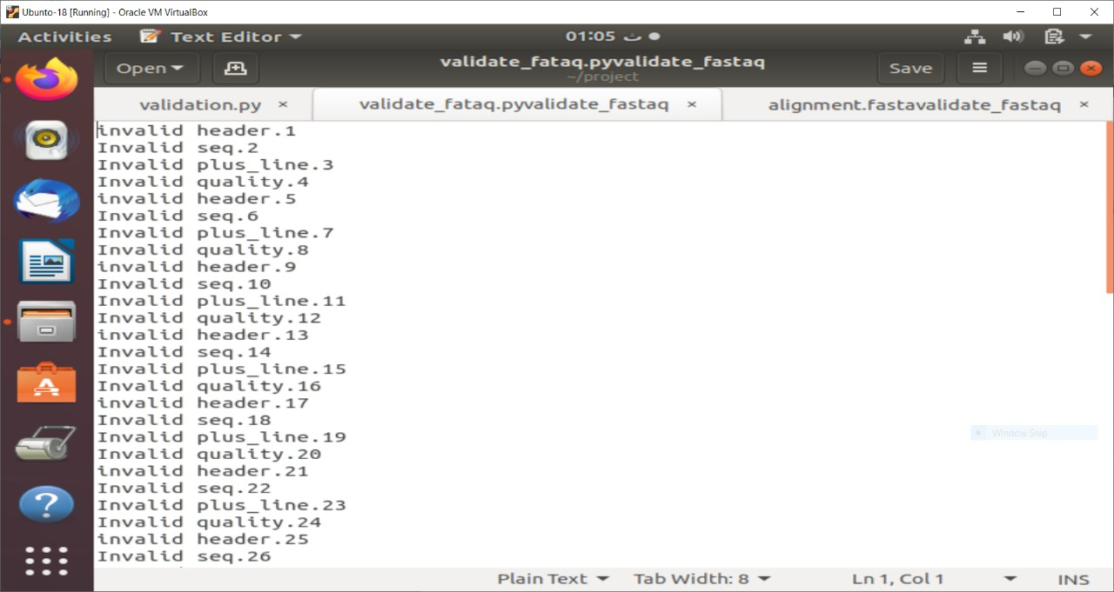
Validate FASTQ
The following details should be included in the result report:
Number of readings in the Sequence FASTq file.
The minimum, maximum, and typical read length.
A list of errors that include the read of sequence included in Header must begin with a '@', Sequence, ‘+’ sign, Quality Score
Mention the error's line number

Slide 32
Statistical operations

Slide 33
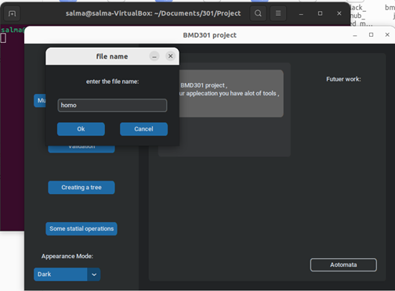
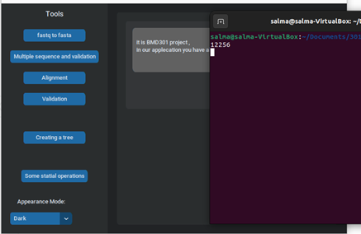

Slide 34
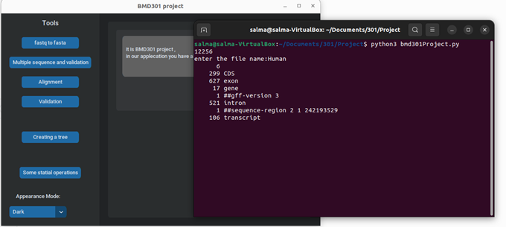

Slide 35
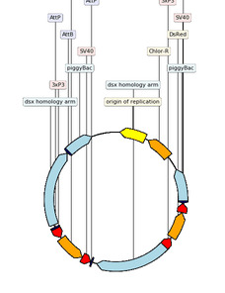
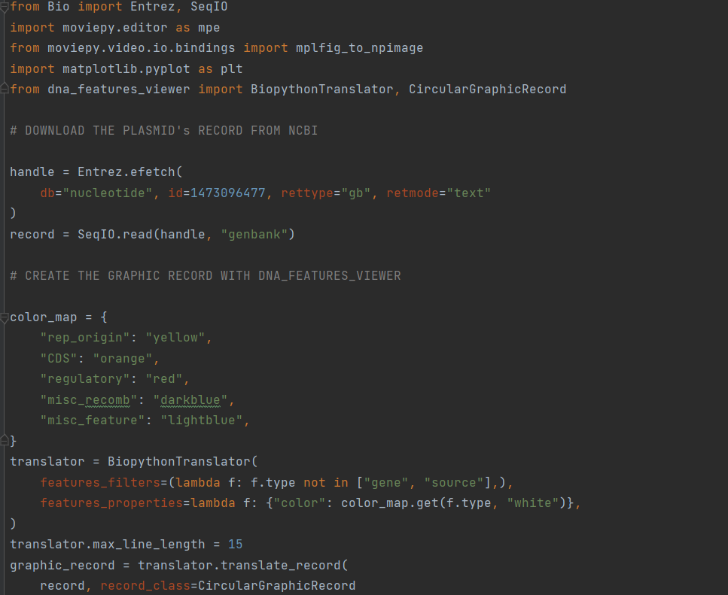
Visualization Of Sequence

Slide 36
Conclusion
We established an automated and reproducible integrative Automated Script by python and bash script that will help the user focus more on revolutionizing and improving the result. by eliminating the requirement for any manual Task. Our software operates form a user-friendly graphic interface that allows software management and installation by users.

Slide 37
Thanks for listening.

